Slide 1





















COAL TO COKE CONVERSION
Pushing
Operation
Selective Crushing
1)Crusing Size
Carbonization
Output
Start
Charging
Operation
Quenching &
Product handling plant
Blending of coal from different sources
Moisture addition
1)GCM pressure and Temp.
2)Charging Temperature
3)Battery Operation Temp
4)Coking time
%age of moisture content
1)Volume of water added
2)Quenching time
1)Push Force
2)PRI
3)Coke per push
2)Coke en﻿d temperature
%ages
1)Bulk Density
2)Blend coal quality parameters.

Slide 2
Model Architecture
Coke qualities :
Ash
VM
Moisture
80
-25
CSR
CRI
M40
M10
Coal Mixture Composition
Coal % from different sources
output layer
a
...
...
crushing
size
% moisture
bulk density
blend coal quality parameters
GCM pressure and temperature
charging temperature
Battery operation temperature
coking
time
coking end
temp( C)
push force
PRI
coke per push
volume of water
quenching time
Quenching time

Slide 3


Coal Mixture Composition
Coal % from different sources

Slide 4
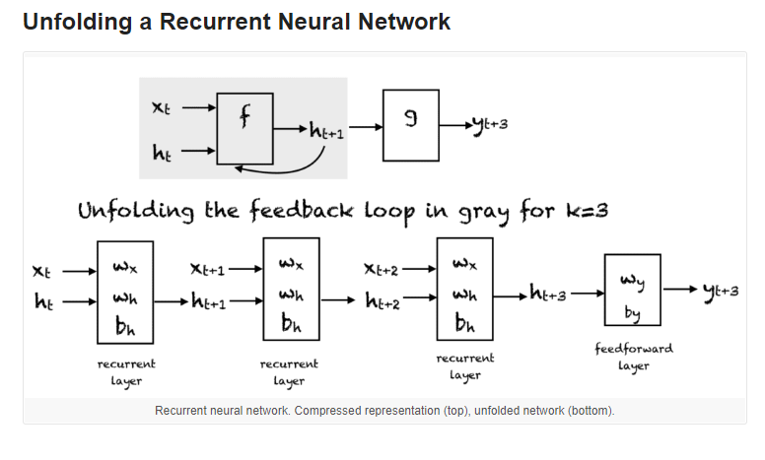

Coal Mixture Composition
crushing
size
Here wi and wh are weights of RNN network
% moisture

Slide 5


Wi*Oi
Coke qualities :
Ash
VM
Moisture
80
-25
CSR
CRI
M40
M10
Final Output of RNN is mapped to ANN to get required properties of coke
output layer
Quenching time

